Slide 1
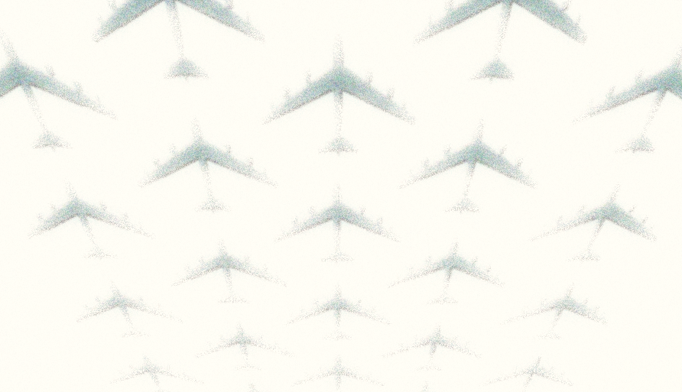
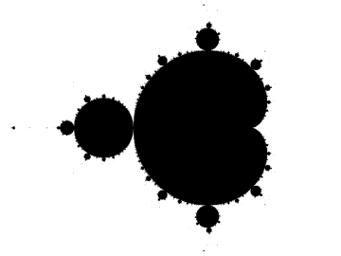
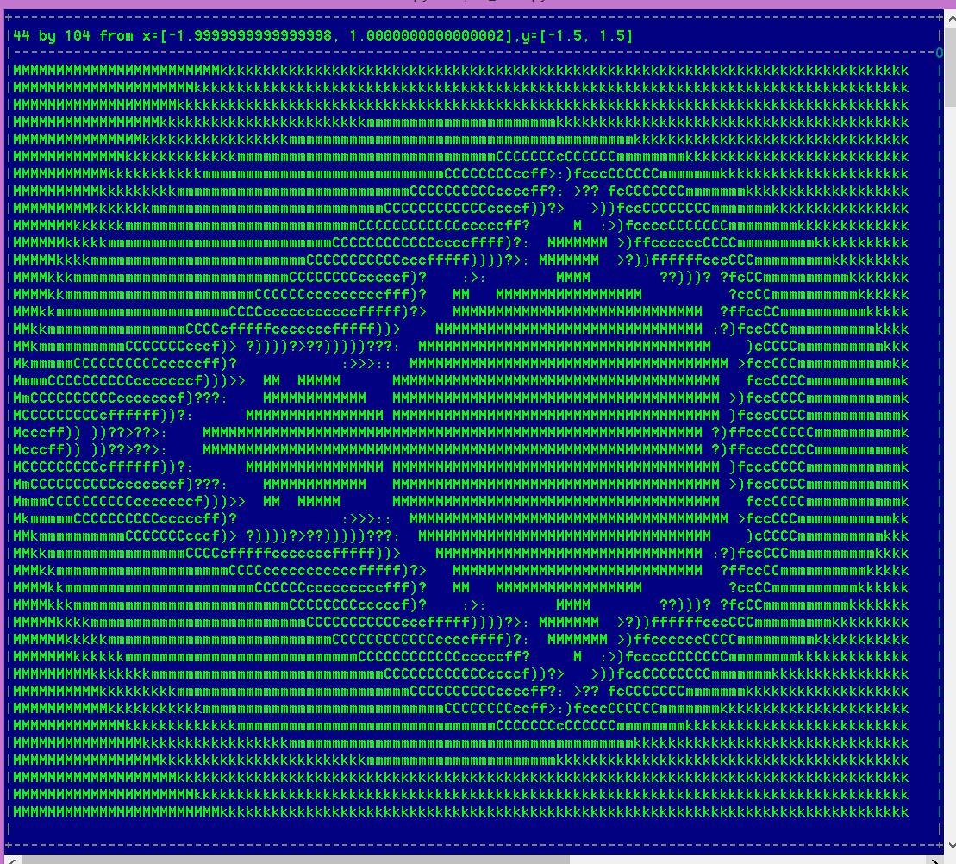
Dr. Mandelbrot
Henry Post
Or: How
I
Learned
To
Stop
Worrying
And
Love
The
Maths
how to render the mandelbrot set in ascii
Notes:
What movie could it be???

Slide 2

What is ‘ASCII’?
ASCII stands for “American Standard Code for Information Interchange”, and is a way of storing numbers and language characters.
It is a 7-bit encoding, supporting $2^{7}=128$ unique characters.
It is not the only standard of its kind. UTF-8 and UTF-16 are 8-byte and 16-byte character encoding schemes, respectively.
A-Z; a-z; ‘!@#$%^&*()_’, whitespace, newlines, etc. are all in ASCII. Some control characters like NUL, SOH, EOT, etc. are used, albeit rarely.

Slide 3
What is ‘Rendering’?
Rendering, in the context of computers, is the process of generating images from a model using computer programs.
It can be rendering squares of a single color, text, 2d graphics, or 3d graphics.
It is what displays the elements on your desktop, the pixels on your screen, and everything else you see on computer screens!
To render things like mathematical sets, you can use your imagination on how to translate a number into a visual object! It doesn’t have to strictly be one value to one color!

Slide 4

A pen-and-paper example of ‘rendering’. (Beware of light math!)
So, let’s suppose we have a 5-by-5 grid of coordinates, such that $x ∈\left[−2, 2\right]$ and $y ∈\left[−2, 2\right]$ for all points on the grid.
What if there were a way to transform each point into a color based off of a mathematical equation?
y\x | -2 | -1 | 0 | 1 | 2
2 | -2,2 | -1,2 | 0,2 | 1,2 | 2,2
1 | -2,1 | -1,1 | 0,1 | 1,1 | 2,1
0 | -2,0 | -1,0 | 0,0 | 1,0 | 2,0
-1 | -2,-1 | -1,-1 | 0,-1 | 1,-1 | 2,-1
-2 | -2,-2 | -1,-2 | 0,-2 | 1,-2 | 2,-2
Let’s use the distance formula in this example, more specifically, each point’s distance from the origin! (This makes a circle!

Slide 5
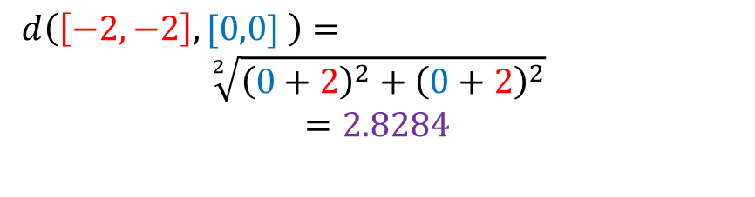
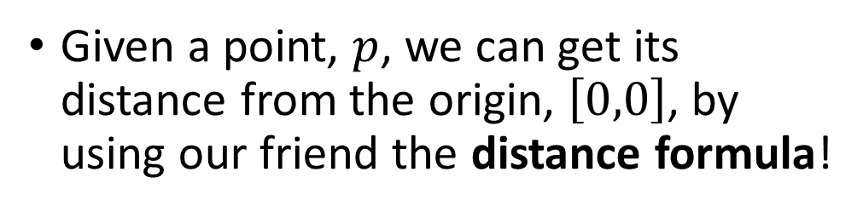
Manual rendering cont…
Given a point, $p$, we can get its distance from the origin, $\left[0,0\right]$, by using our friend the distance formula!
y\x | -2 | -1 | 0 | 1 | 2
2 | -2,2 | -1,2 | 0,2 | 1,2 | 2,2
1 | -2,1 | -1,1 | 0,1 | 1,1 | 2,1
0 | -2,0 | -1,0 | 0,0 | 1,0 | 2,0
-1 | -2,-1 | -1,-1 | 0,-1 | 1,-1 | 2,-1
-2 | -2,-2 | -1,-2 | 0,-2 | 1,-2 | 2,-2
$d\left(p_{1},p_{2}\right)=\sqrt[2]{{\left(p_{2}.x−p_{1}.x\right)}^{2}+{\left(p_{2}.y−p_{1}.y\right)}^{2}}$
$d\left(\left[−2,−2\right],[0,0] \right)=$
$$\sqrt[2]{{\left(0+2\right)}^{2}+{\left(0+2\right)}^{2}}$$
$$=2.8284$$

Slide 6
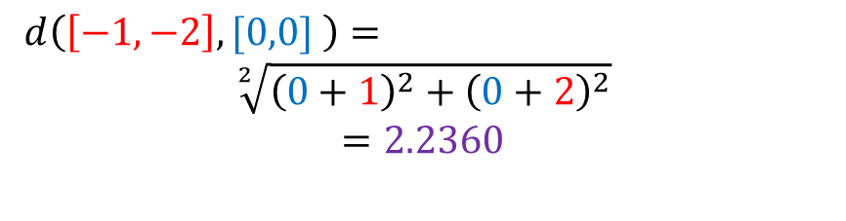
Manual rendering cont…
Given a point, $p$, we can get its distance from the origin, $\left[0,0\right]$, by using our friend the distance formula!
y\x | -2 | -1 | 0 | 1 | 2
2 | 2.82 | -1,2 | 0,2 | 1,2 | 2,2
1 | -2,1 | -1,1 | 0,1 | 1,1 | 2,1
0 | -2,0 | -1,0 | 0,0 | 1,0 | 2,0
-1 | -2,-1 | -1,-1 | 0,-1 | 1,-1 | 2,-1
-2 | -2,-2 | -1,-2 | 0,-2 | 1,-2 | 2,-2
$d\left(p_{1},p_{2}\right)=\sqrt[2]{{\left(p_{2}.x−p_{1}.x\right)}^{2}+{\left(p_{2}.y−p_{1}.y\right)}^{2}}$
$d\left(\left[−1,−2\right],[0,0] \right)=$
$$\sqrt[2]{{\left(0+1\right)}^{2}+{\left(0+2\right)}^{2}}$$
$$=2.2360$$

Slide 7
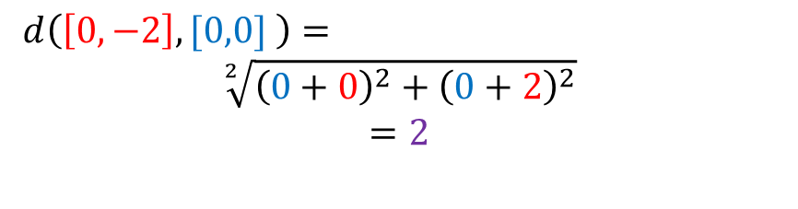
Manual rendering cont…
Given a point, $p$, we can get its distance from the origin, $\left[0,0\right]$, by using our friend the distance formula!
y\x | -2 | -1 | 0 | 1 | 2
2 | 2.82 | 2.23 | 0,2 | 1,2 | 2,2
1 | -2,1 | -1,1 | 0,1 | 1,1 | 2,1
0 | -2,0 | -1,0 | 0,0 | 1,0 | 2,0
-1 | -2,-1 | -1,-1 | 0,-1 | 1,-1 | 2,-1
-2 | -2,-2 | -1,-2 | 0,-2 | 1,-2 | 2,-2
$d\left(p_{1},p_{2}\right)=\sqrt[2]{{\left(p_{2}.x−p_{1}.x\right)}^{2}+{\left(p_{2}.y−p_{1}.y\right)}^{2}}$
$d\left(\left[0,−2\right],[0,0] \right)=$
$$\sqrt[2]{{\left(0+0\right)}^{2}+{\left(0+2\right)}^{2}}$$
$$=2$$

Slide 8
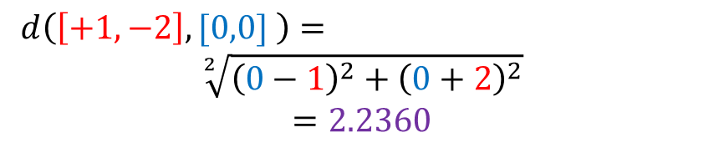
Manual rendering cont…
Given a point, $p$, we can get its distance from the origin, $\left[0,0\right]$, by using our friend the distance formula!
y\x | -2 | -1 | 0 | 1 | 2
2 | 2.82 | 2.23 | 2 | 1,2 | 2,2
1 | -2,1 | -1,1 | 0,1 | 1,1 | 2,1
0 | -2,0 | -1,0 | 0,0 | 1,0 | 2,0
-1 | -2,-1 | -1,-1 | 0,-1 | 1,-1 | 2,-1
-2 | -2,-2 | -1,-2 | 0,-2 | 1,-2 | 2,-2
$d\left(p_{1},p_{2}\right)=\sqrt[2]{{\left(p_{2}.x−p_{1}.x\right)}^{2}+{\left(p_{2}.y−p_{1}.y\right)}^{2}}$
$d\left(\left[+1,−2\right],[0,0] \right)=$
$$\sqrt[2]{{\left(0−1\right)}^{2}+{\left(0+2\right)}^{2}}$$
$$=2.2360$$

Slide 9
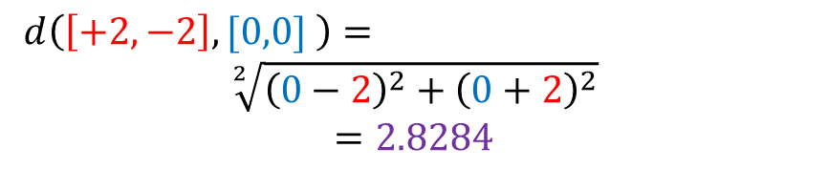
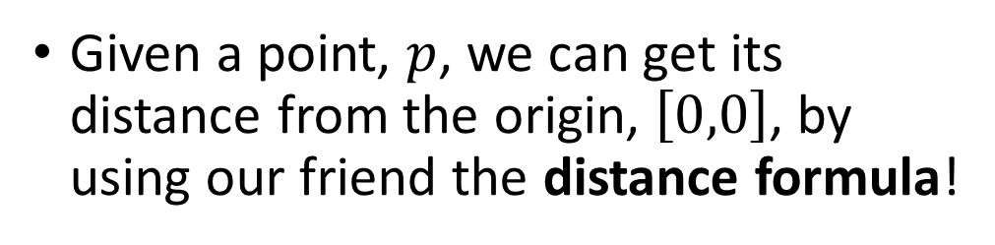
Manual rendering cont…
Given a point, $p$, we can get its distance from the origin, $\left[0,0\right]$, by using our friend the distance formula!
y\x | -2 | -1 | 0 | 1 | 2
2 | 2.82 | 2.23 | 2 | 2.23 | 2,2
1 | -2,1 | -1,1 | 0,1 | 1,1 | 2,1
0 | -2,0 | -1,0 | 0,0 | 1,0 | 2,0
-1 | -2,-1 | -1,-1 | 0,-1 | 1,-1 | 2,-1
-2 | -2,-2 | -1,-2 | 0,-2 | 1,-2 | 2,-2
$d\left(p_{1},p_{2}\right)=\sqrt[2]{{\left(p_{2}.x−p_{1}.x\right)}^{2}+{\left(p_{2}.y−p_{1}.y\right)}^{2}}$
$d\left(\left[+2,−2\right],[0,0] \right)=$
$$\sqrt[2]{{\left(0−2\right)}^{2}+{\left(0+2\right)}^{2}}$$
$$=2.8284$$

Slide 10

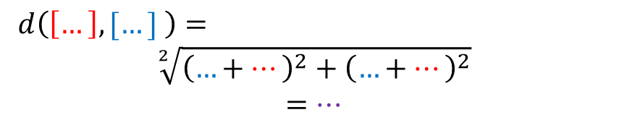
Manual rendering cont…
Given a point, $p$, we can get its distance from the origin, $\left[0,0\right]$, by using our friend the distance formula!
y\x | -2 | -1 | 0 | 1 | 2
2 | 2.82 | 2.23 | 2 | 2.23 | 2.82
1 | 2.23 | 1.41 | 1 | 1.41 | 2.23
0 | 2 | 1 | 0 | 1 | 2
-1 | 2.23 | 1.41 | 1 | 1.41 | 2.23
-2 | 2.82 | 2.23 | 2 | 2.23 | 2.82
$d\left(p_{1},p_{2}\right)=\sqrt[2]{{\left(p_{2}.x−p_{1}.x\right)}^{2}+{\left(p_{2}.y−p_{1}.y\right)}^{2}}$
$d\left(\left[…\right],[…] \right)=$
$$\sqrt[2]{{\left(…+…\right)}^{2}+{\left(…+…\right)}^{2}}$$
$$=…$$

Slide 11


That’s nice, but this isn’t a picture/ASCII art!
That’s right. We need a way to map each number to a color or character!
Let’s use a function to translate our numbers!
For each number, it will be resolved by the following step function:
$f\left(x\right)=\left\{\begin{matrix}′@′ & x∈\left(−∞,1\right] \\ ′∗′ & x∈(1,2] \\ . & x∈(2,∞] \end{matrix}\right.$
y\x | -2 | -1 | 0 | 1 | 2
2 | 2.82 | 2.23 | 2 | 2.23 | 2.82
1 | 2.23 | 1.41 | 1 | 1.41 | 2.23
0 | 2 | 1 | 0 | 1 | 2
-1 | 2.23 | 1.41 | 1 | 1.41 | 2.23
-2 | 2.82 | 2.23 | 2 | 2.23 | 2.82

Slide 12
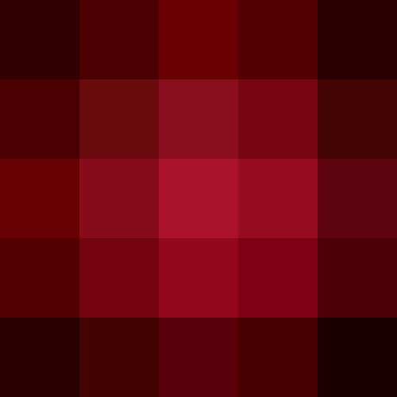

That’s nice, but this isn’t a picture!
Likewise, instead of characters, we can map each number to a color!
Here is a similar function, simplified:
$f\left(x\right)=RGB\left(\frac{\left|x−max\right|}{max},0,0\right)$ where $max=3$
We can assume that as we get closer to the center, the pixels will get redder. For example, $x$ being zero will yield $RGB(1,0,0)$ which is just red.
This image was automatically generated by python code included with this project.
y\x | -2 | -1 | 0 | 1 | 2
2 | 2.82 | 2.23 | 2 | 2.23 | 2.82
1 | 2.23 | 1.41 | 1 | 1.41 | 2.23
0 | 2 | 1 | 0 | 1 | 2
-1 | 2.23 | 1.41 | 1 | 1.41 | 2.23
-2 | 2.82 | 2.23 | 2 | 2.23 | 2.82

Slide 13

What is the ‘Mandelbrot Set’?
The Mandelbrot set is a set (list) of numbers which satisfy a formula.
The formula in question is very simple and whether or not they satisfy it is easy to understand.
$z_{n+1}={z_{n}}^{2}+c$ with $z_{0}=c$, where $z_{n}$ does not go to infinity when you repeatedly plug in $z$ to the formula.
$z$ is a real number, horizontal, and $c$ is an imaginary number, vertical.
So, when a number is repeatedly squared, the y-axis is added onto it, and then plugged into the aforementioned formula and it does NOT diverge to infinity, it is said to be inside the set.

Slide 14

How do we compute it?
Well, we first need a list of coordinates to plug into our formula.
Let’s take a 10x10 grid from $z∈\left[−1,1\right]$ and $c∈\left[−1,1\right]$!
The number that results can either be the value we’re left with, or how many iterations of plugging in the numbers to the formula it took before it began to diverge to infinity.
In this case, let’s do the former, as it’s easier to do.
Common sense tells us that places around $[0,0]$ will definitely be inside the set because a number lower than 1 squared will simply get smaller!

Slide 15
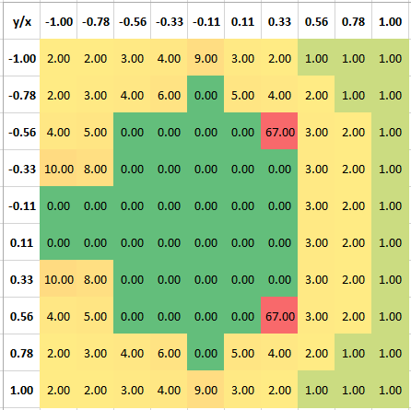
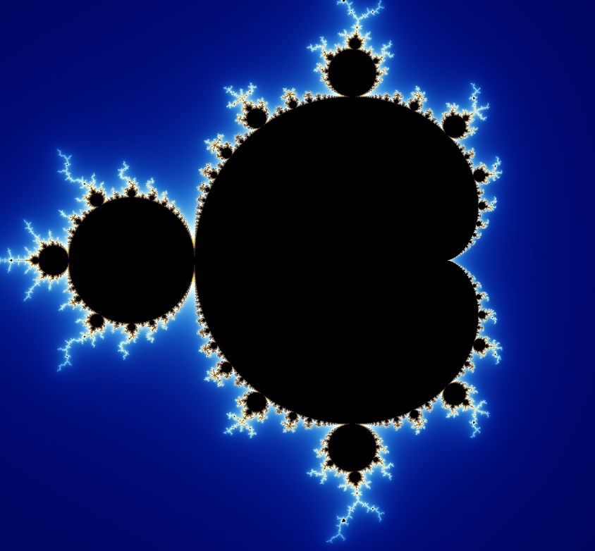
How do we compute it?
y/x | -1.00 | -0.78 | -0.56 | -0.33 | -0.11 | 0.11 | 0.33 | 0.56 | 0.78 | 1.00
-1.00 | 2.00 | 2.00 | 3.00 | 4.00 | 9.00 | 3.00 | 2.00 | 1.00 | 1.00 | 1.00
-0.78 | 2.00 | 3.00 | 4.00 | 6.00 | 0.00 | 5.00 | 4.00 | 2.00 | 1.00 | 1.00
-0.56 | 4.00 | 5.00 | 0.00 | 0.00 | 0.00 | 0.00 | 67.00 | 3.00 | 2.00 | 1.00
-0.33 | 10.00 | 8.00 | 0.00 | 0.00 | 0.00 | 0.00 | 0.00 | 3.00 | 2.00 | 1.00
-0.11 | 0.00 | 0.00 | 0.00 | 0.00 | 0.00 | 0.00 | 0.00 | 3.00 | 2.00 | 1.00
0.11 | 0.00 | 0.00 | 0.00 | 0.00 | 0.00 | 0.00 | 0.00 | 3.00 | 2.00 | 1.00
0.33 | 10.00 | 8.00 | 0.00 | 0.00 | 0.00 | 0.00 | 0.00 | 3.00 | 2.00 | 1.00
0.56 | 4.00 | 5.00 | 0.00 | 0.00 | 0.00 | 0.00 | 67.00 | 3.00 | 2.00 | 1.00
0.78 | 2.00 | 3.00 | 4.00 | 6.00 | 0.00 | 5.00 | 4.00 | 2.00 | 1.00 | 1.00
1.00 | 2.00 | 2.00 | 3.00 | 4.00 | 9.00 | 3.00 | 2.00 | 1.00 | 1.00 | 1.00
Fortunately for us, Excel includes a cool feature called ‘conditional formatting’!
This means that we can color in cells based on their value!
This already looks suspiciously like the cool image on the first page of the slideshow…that’s because it is!

Slide 16
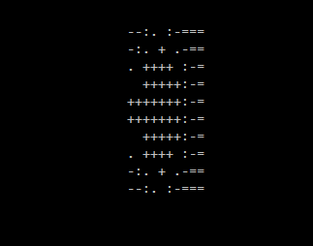

How do we turn numbers into ASCII?
Just like the other ‘step’ function that turned numbers into ASCII, we can use a similar one here!
I used the following scale: ‘ .:-=+*#%@’. It is 10 characters long.
$f\left(x\right)=\left\{\begin{matrix}′ ′ if & x∈ & [0,1) \\ \begin{aligned}′.′ if \\ … \\ ′\%′ if\end{aligned} & \begin{aligned}x∈ \\ … \\ x∈\end{aligned} & \begin{aligned}[1,2) \\ … \\ [8,9)\end{aligned} \\ ′@′ if & x∈ & [9,10)\end{matrix}\right.$

Slide 17
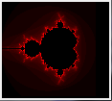
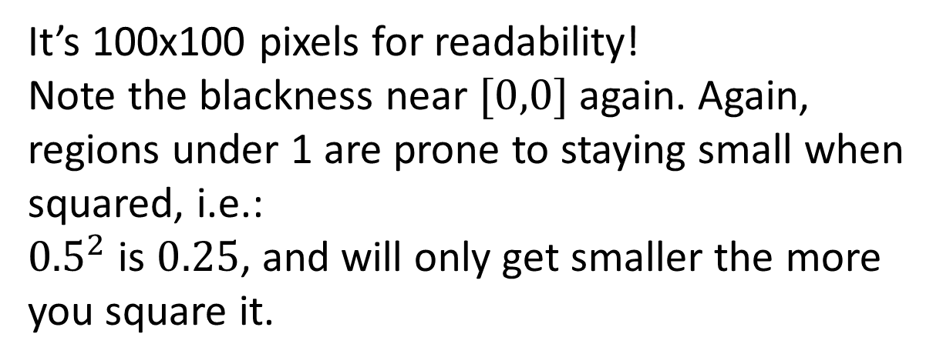
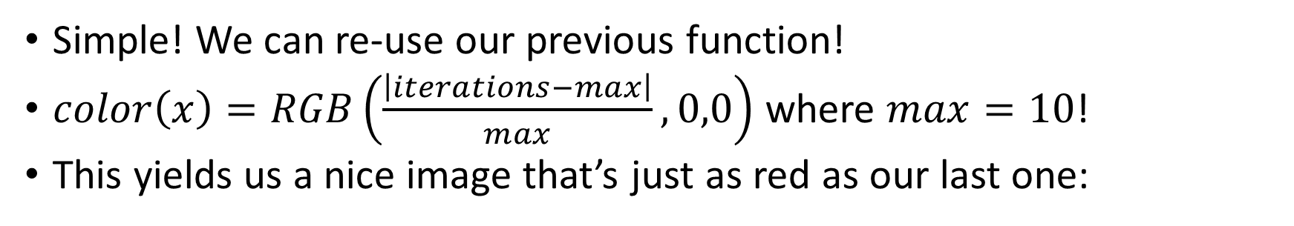
How do we turn numbers into pixels?
Simple! We can re-use our previous function!
$color\left(x\right)=RGB\left(\frac{\left|iterations−max\right|}{max},0,0\right)$ where $max=10$!
This yields us a nice image that’s just as red as our last one:
It’s 100x100 pixels for readability!
Note the blackness near $[0,0]$ again. Again, regions under 1 are prone to staying small when squared, i.e.:
${0.5}^{2}$ is $0.25$, and will only get smaller the more you square it.

Slide 18
Why would you do this?
I was bored and deprived of videogames!
I like to program!
I was reading some cool books about fractals and got inspired!
I like looking at pretty pictures!
ASCII art is a cool aesthetic!

Slide 19
What now?
See my source code at: https://github.com/HenryFBP/wyzant/tree/master/python3/shapes
Run it for yourself!
Make a 2000 by 2000 pixel Mandelbrot wallpaper!
Optimize it for me because my code runs extremely slow and I can’t be bothered to do it myself!

